Slide 1


Salary analysis in Data science domain
By Neha Inder Malviya
Tools used:
Jupyter
Excel

Slide 2
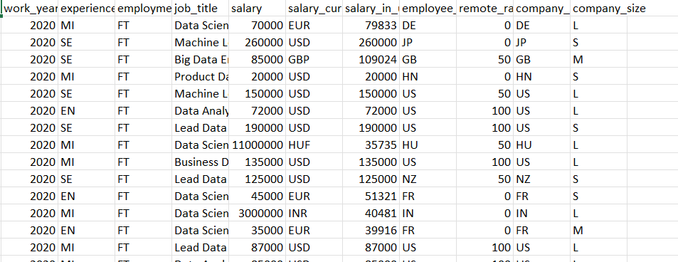

SUMMARY OF DATASET
The dataset is divided based on the experience levels which include EN (Entry Level), MI (Mid Level) and SE (Senior Level).
The employment types in the dataset consists of FT (Full time) and ET (Part time).
The locations of the company world-wide are United States (US), India (IN), Japan (JP), Hungary (HU), France (FR), and others.
The salaries in the dataset range from around around $20,000 to $299,000 USD, with a median salary of around $85,000 USD.
The dataset includes job titles such as Data Scientist, Machine Learning Engineer, Big Data Engineer, Data Analyst, and Lead Data Scientist.

Slide 3
KPIs
Average Salary of Data Scientists in India
Average Salary of Data Scientists in USA
Average Salary of Data Analysts in India
Average Salary of Data Analysts in USA
Top 10 Employee Residence
Top companies by size and location
Count of experience level by experience
Remote ratio distribution
Job title distribution by remote ratio
Employment Type

Slide 4
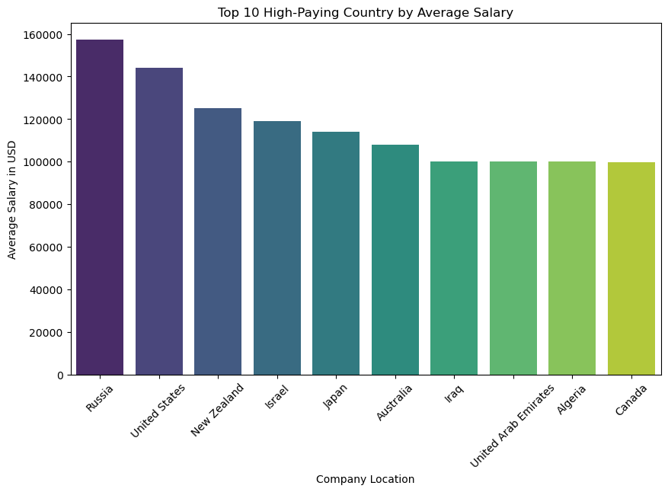
Details:
A bar chart shows the average salaries (in USD) of the top 10 countries.
The Y-axis represents salaries, while the X-axis lists the countries.
Countries are ranked by the average salary, with the highest-paying countries appearing first.
Insights:
This visualization helps identify which countries offer the highest compensation in data science roles.
Could be influenced by living costs, demand for data science roles, or economic factors.

Slide 5
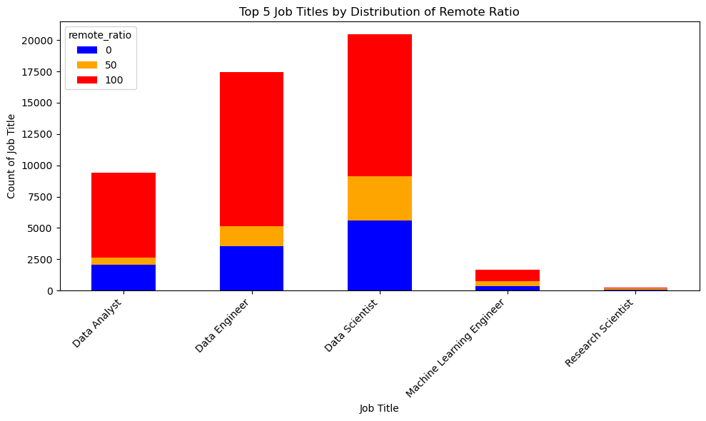
Top 5 Job Titles by Distribution of Remote Ratio
Details:
A bar chart categorizes the distribution of jobs by remote work ratio (0%, 50%, 100%) for the top 5 job titles.
Job titles are listed on the X-axis, and their frequency or count is shown on the Y-axis.
Insights:
The chart highlights the degree of remote work flexibility for different roles.
Remote-friendly roles have a higher 100% remote ratio, while some roles might lean toward on-site or hybrid arrangements.

Slide 6
WORKING ON THE DATSET
Connect to the database.
Import data into Excel.
Import the Excel data to python Jupyter notebook.
Create appropriate visuals and reports.
Build the python report.
TASK 1
Importing the data from the server
Excel Dashboard
TASK 2
Importing the data into Python JupyterNote book
Analysis Jupyter Notebook

Slide 7
CONCLUSION
A detailed data analysis is done for the given dataset of Data Science Job Salaries. It can be concluded that:
The variation of salaries across type of employment such as Contract basis, Full-time, etc. is very crucial.
The variation of salaries as you gain experience is a rising curve.
Data Scientist is the most common job title in the company.
USA contributes the most amount of residents working for the company.
References:
Dataset- https://www.kaggle.com/datasets/ruchi798/data-science-job-salaries

